Slide 1


Risk Management for Projects
Said Fawzy
Section 4:
Risk response

Slide 2
Module Contents
Why risk response?
Risk ownership
Project types
Where to now?
Discussion: Risk response
FAQs

Slide 3
1 Why risk response?

Slide 4
What you will learn in this section
In this section, you will learn how to: Identify methods of responding to risk.

Slide 5
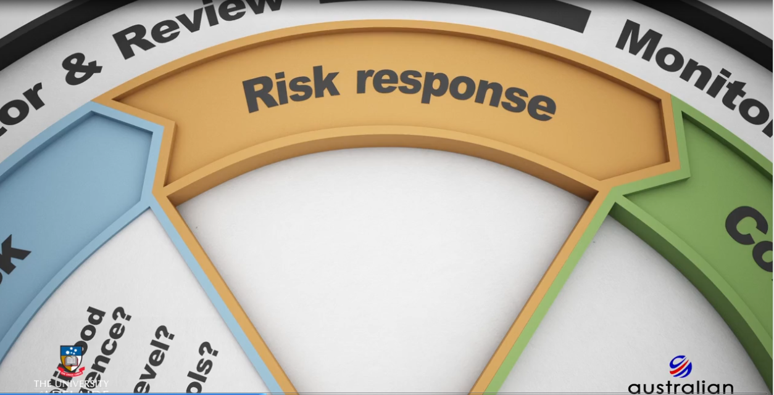
The risk response canvas

Slide 6
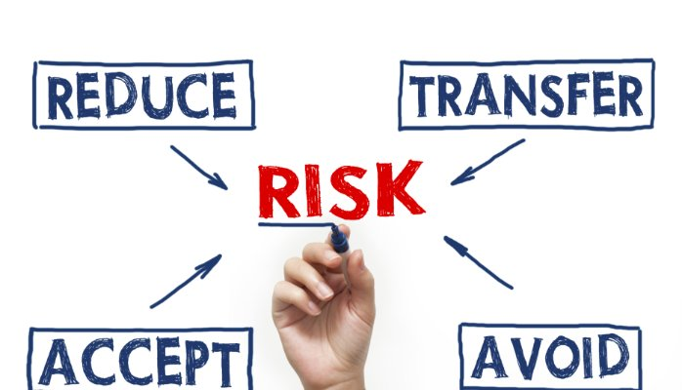
Risk response :
The purpose is to decide how you will respond to each risk.
Decide on what actions you may want to implement to:
minimize losses or
maximize opportunities in your projects.
This involves finding ways of eliminating, reducing, or controlling the level of each assessed risk.

Slide 7
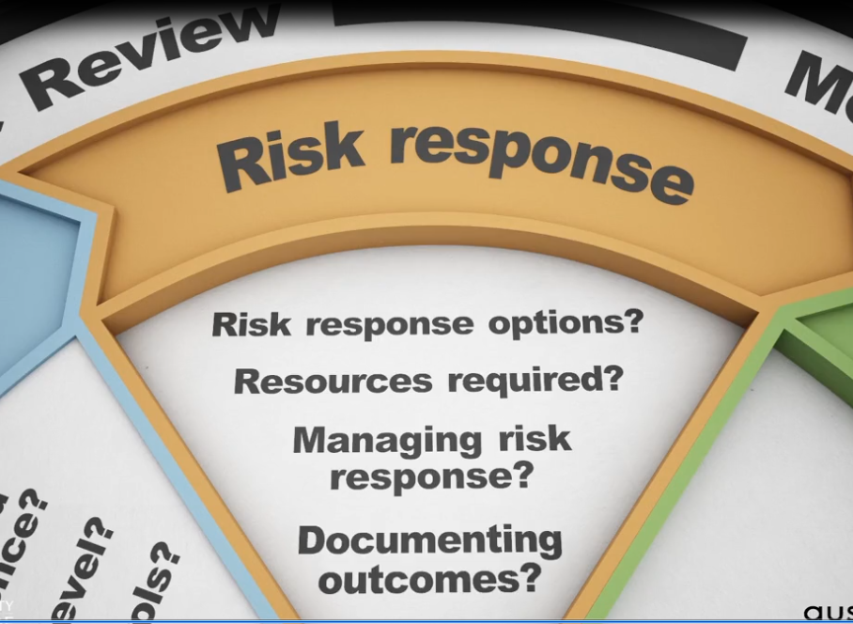
Question to consider in this stage:

Slide 8
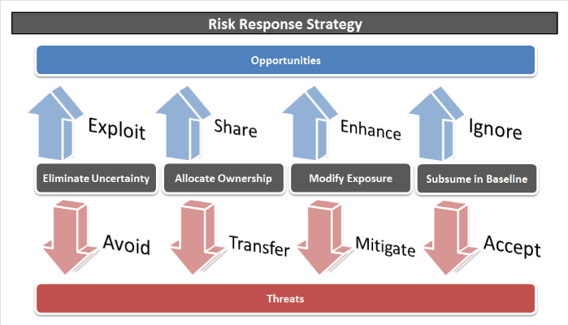
Response to risk
Consider what you believe the most appropriate response to be.
Developing response options and determining from these options what the preferred course of action.
Risk responses need to be planned.
Decisions on risk responses should be tested
Alternative scenarios should be considered.

Slide 9
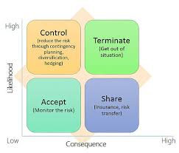




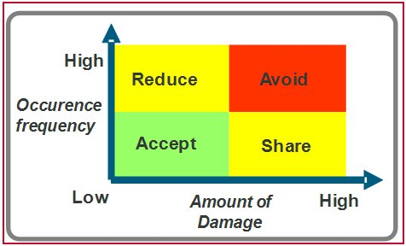

What is risk response and the 4Ts?
your response options
which of these responses might be most appropriate to the risks you identified and assessed in the Western Savannah case

Slide 10
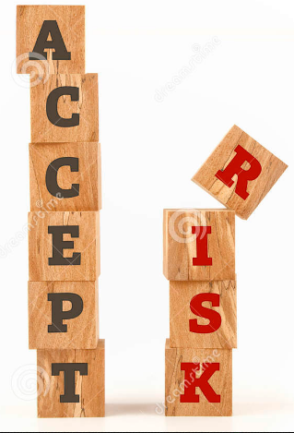


You are agreeing to accept the gross risk.
You are not going to put into place any specific actions.
Your risk appetite is such that you acknowledge the risk.

Slide 11

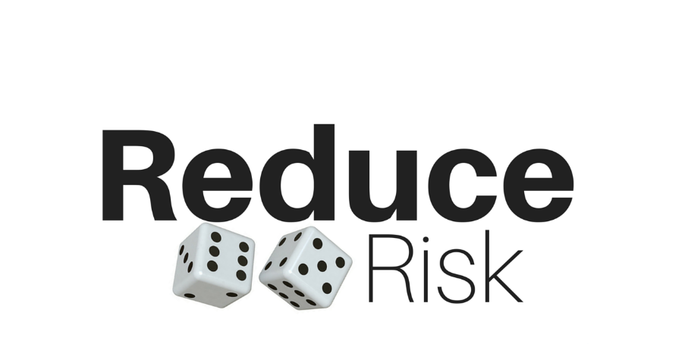

You will be putting into place actions or controls that are aimed at reducing that risk.
This
is often referred to as "mitigating the risk."
the risk cannot be avoided, but there are things that can alleviate its impact on the project

Slide 12

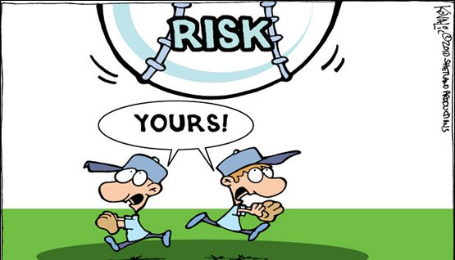

Transfer an identified risk in full or in part to someone else.
Assigning responsibility to another party, such as a contractor or agency, who will then become responsible for dealing with it

Slide 13

This needs to be carefully thought through.
In projects, we have found that this option is only effective if the other party is willing to accept the risk and is better equipped to manage it than the project manager.

Slide 14

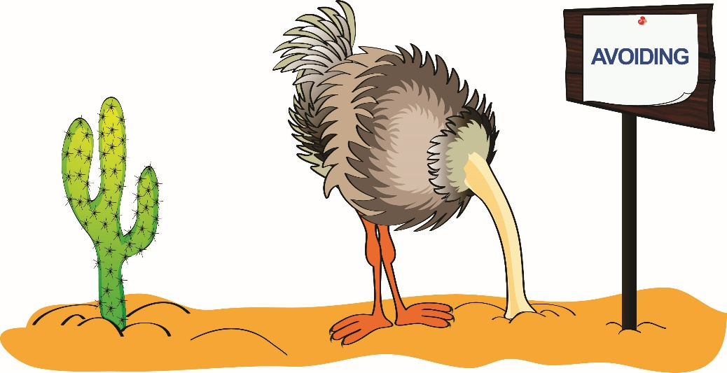
You have decided to eliminate the risk completely.
For example :
Changing risky process or practice to remove the risk
changing the project scope.

Slide 15

Combine options:
You are also able to combine risk response options.
Actions taken by project managers are often a combination of take and treat.
before any response is decided on, you need to carefully consider the costs.
risk responses must consider the impact that the risk could have on the project to ensure that risk response efforts are both efficient and effective.

Slide 16





Slide 17
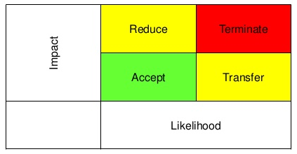
Planning a risk response: Treatment and Transfer

Slide 18

Treat (Reduce or Mitigate):
If you do decide to treat the risk, you will need to gather more information by asking the following questions:

Slide 19


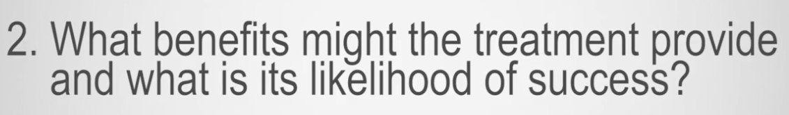


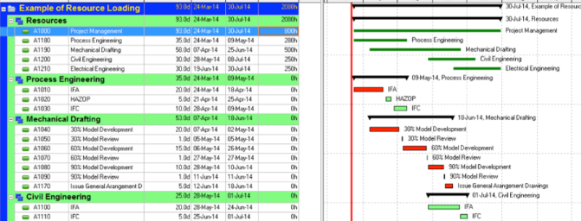
Treat (Reduce or Mitigate):

Slide 20
The level of treatment plan
determine the level of treatment plan based on the level of each assessed risk.

Slide 21

Example :
Need treatment plan
may not require a treatment plan.

Slide 22

Stakeholders commitment
Effective risk treatment relies on attaining commitment from key stakeholders and developing realistic objectives and timelines for implementation

Slide 23

Treatment plan
Need to be carefully documented .
Any relationships or interdependencies with other risks should also be highlighted.
Specify a date or a trigger when risk treatment will commence and when it will conclude.
The time frame should be realistic and appropriate

Slide 24
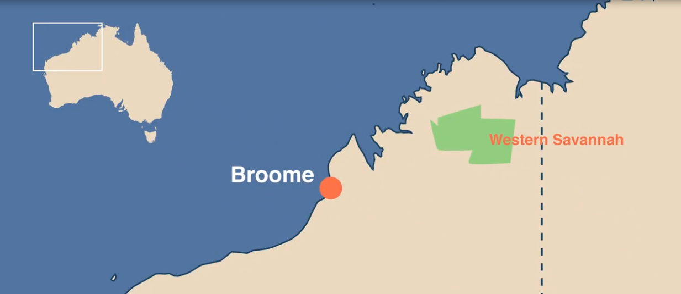
Q: Western Savannah
What might suitable time frames be to treat identified risks, considering the hotel and related infrastructure is to be completed within two years?

Slide 25
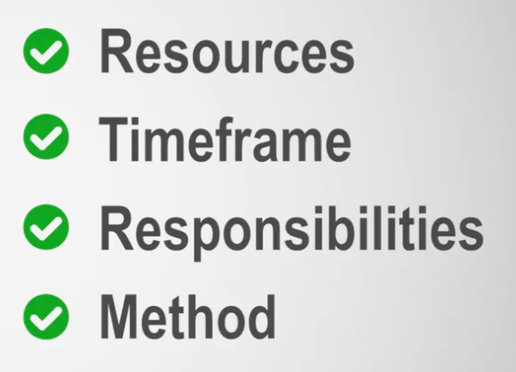
Treatment Summary :

Slide 26

Transfer Risk :
Means you are shifting the burden of the risk so to speak on to someone else

Slide 27



Bear in mind, transferring risk only works for you if the contractor is in a better position to manage the risk than what you are.

Slide 28
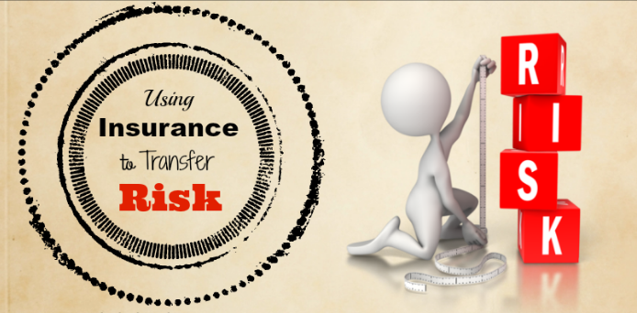

Insurance

Slide 29

Currency insurance :
by buying forward exchange cover contracts

Slide 30
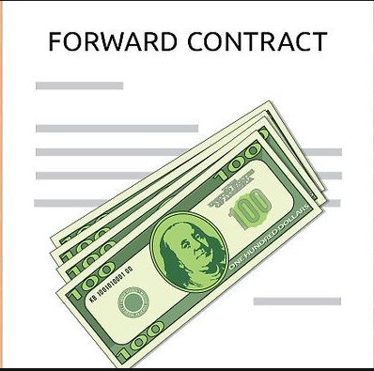
Forward exchange contract (FEC or forward cover)
It is a contract between a bank and its customer, whereby a rate of exchange is fixed immediately, for the buying and selling of one currency for another, for delivery at an agreed future date.

Slide 31
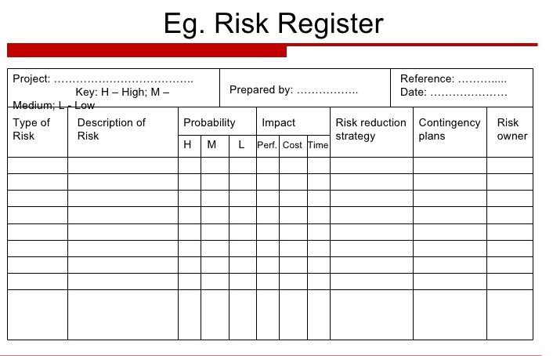
Detailed records about :
Treating risks,
The given context
What actions need to be performed by whom, and
What deadlines or criteria you have set for ensuring they are done properly and on time.

Slide 32
Knowledge check 1:
Risk response

Slide 33

Question 1
What are "treat", "transfer", "terminate" and "take" all examples of?
Risks
Contingencies
Uncertainties
Responses
Explanation
All identified risks need to be responded to in one way or another. "Treat", "transfer", "terminate" and "take" are also referred to as the 4Ts.

Slide 34
Question 2
Which of the following are valid reasons for managing risk on a project? Identify each valid reason
To minimise the likelihood of the risk
To minimise the unfavourable consequences of the risk
To maximise the probability of favourable consequences of the risk
To provide a warning system as late as possible
Explanation
All identified risks need to be responded to in one way or another. It is about anticipating and informing decision making.

Slide 35
Question 3
What is the term for a risk response strategy that generally reduces the probability or impact of the event without altering the project's objectives?
Avoidance Response
Treat Response
Take Response
Transfer Response
Explanation
Treating the risk is often referred to as mitigating the risk (or risk mitigation), which means putting into place actions that will reduce the risk.

Slide 36
Question 4
True of false? One type of risk response is to ignore the risk.
True
False
Explanation
All identified risks need to be responded to in one way or another. Remember that the four main risk responses (the 4Ts) are to treat, terminate, take or transfer. A risk cannot be ignored. If a risk is ignored, it can negatively impact on the cost and resources of the project.

Slide 37
Question 5
True of false? Transferring risk to another party is a preferred risk response when the other party is willing to accept the risk and is more capable of managing it.
True
False
Explanation
Lessons learnt show that transfer should only be selected if the other party is willing and more capable of managing the risk.

Slide 38
2 Risk ownership

Slide 39
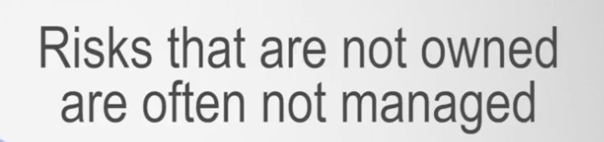
Risk ownership and assigning risk

Slide 40


Risk owner is not the one…
When risk occurs….
We fire .

Slide 41


Risk ownership and assigning risk
Risk ownership is incremental in ensuring an identified risk is:
managed,
monitored, and
controlled
throughout the risk management process
It is a dynamic and continual process.

Slide 42

So what do you need to consider when assigning risks to an owner?
The most appropriate person takes on the responsibility of monitoring that risk.

Slide 43



Example :
IT Risks

Slide 44
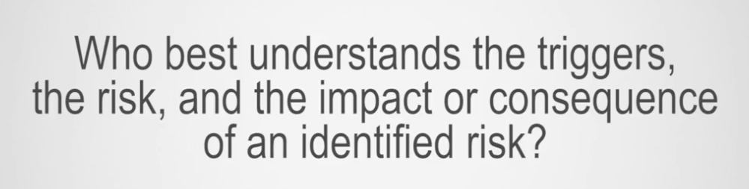

questions to ensure that your decision is fit for purpose:

Slide 45


questions to ensure that your decision is fit for purpose:

Slide 46


questions to ensure that your decision is fit for purpose:

Slide 47


questions to ensure that your decision is fit for purpose:

Slide 48
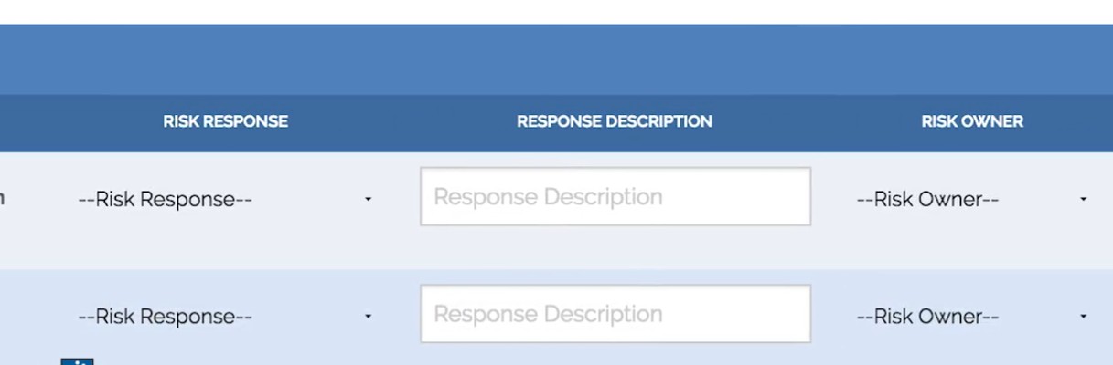
Selected the risk owner should be added to the risk register

Slide 49

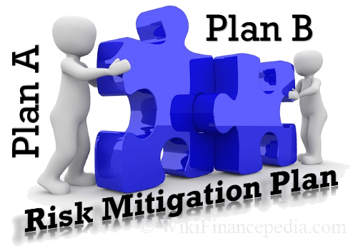
Risk Owner Job :
determines which risks require mitigation and contingency plans,

Slide 50


Risk Owner Job :
generates the risk mitigation and contingency strategies

Slide 51


Risk Owner Job :
performs a cost benefit analysis of the proposed strategies

Slide 52
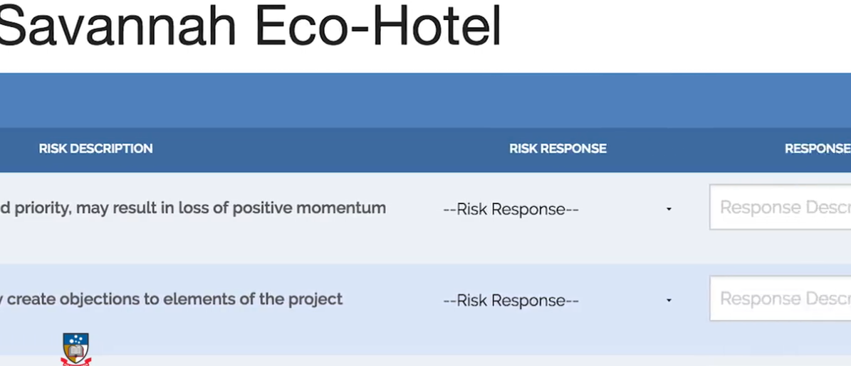
The responsibilities of risk owners :
the assessment of their risk and subsequent response

Slide 53

The responsibilities of risk owners :
Reporting to the project manager,
on a regular and continual basis

Slide 54

Risks should be discussed as part of the weekly progress or status meeting during which the risk owners will provide updates on the respective, identified risks.
Risk Owners
Manager

Slide 55
Complete the risk register: Part 3
Go to Excersice folder and open
Complete the risk register_ Part 3 _ Risk ownership _ RiskX Courseware _ edX.html

Slide 56
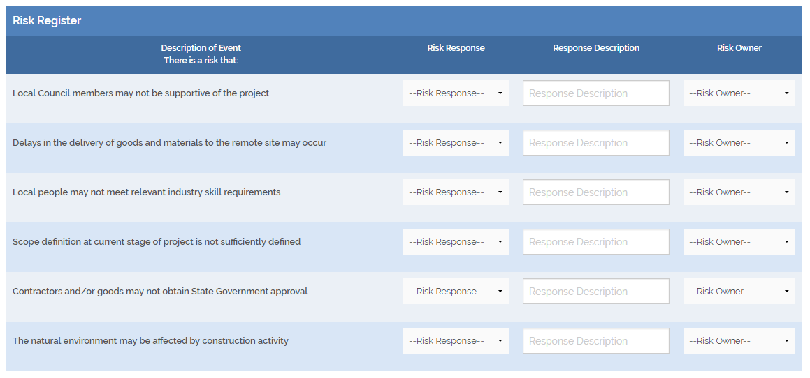

Slide 57
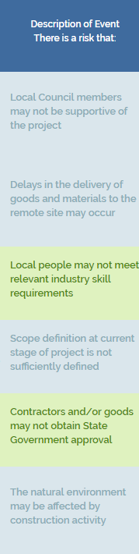
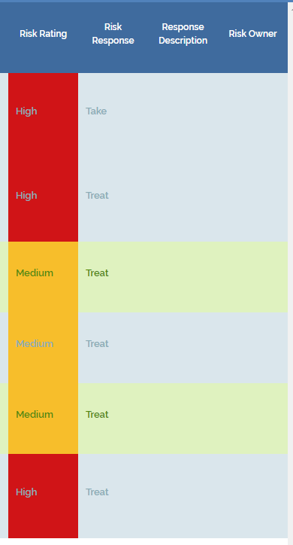

Slide 58
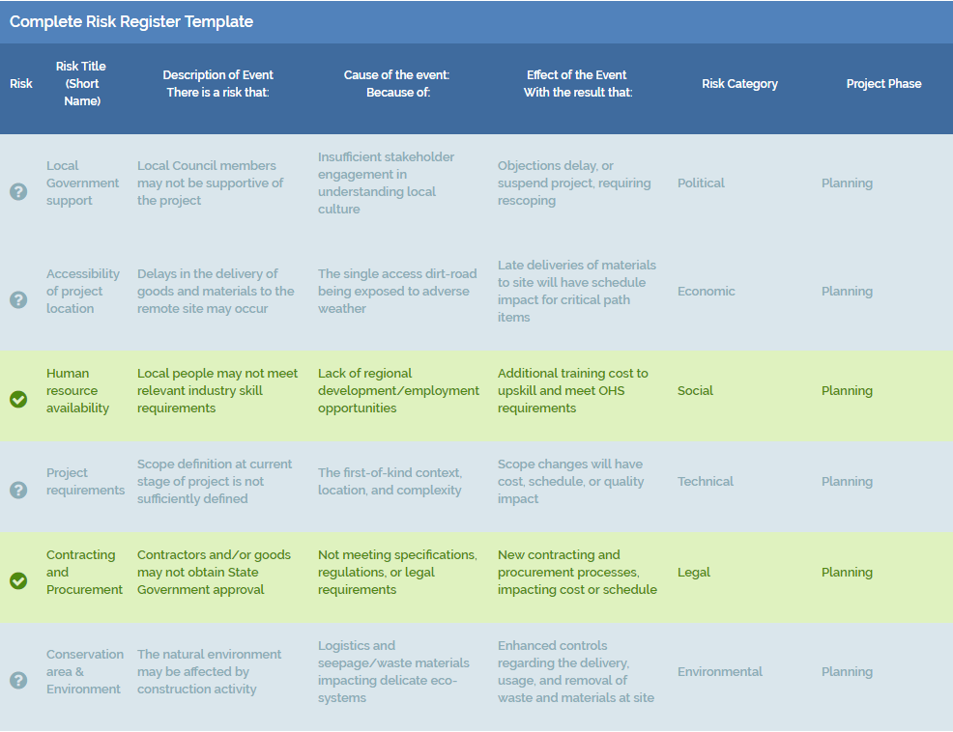
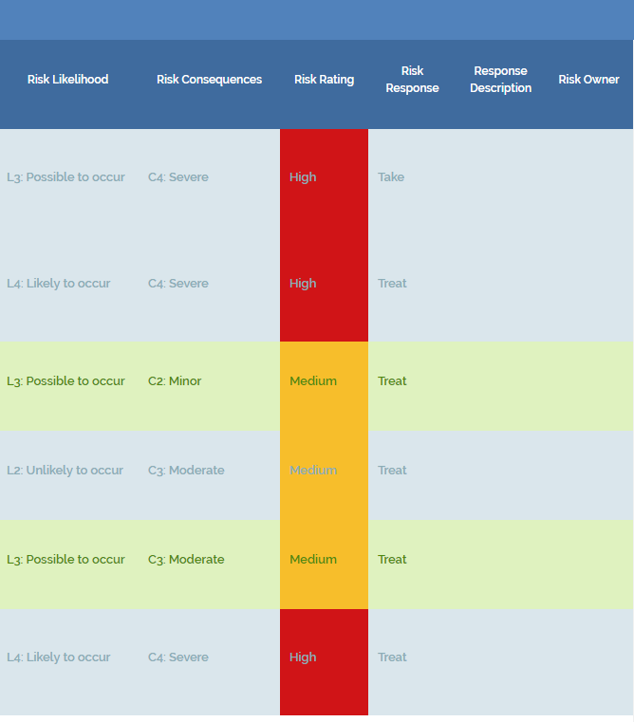

Slide 59
Tips and Traps to consider
Now that you have worked through the process of responding to the identified risks, there are a couple of points for you to consider and be aware of when you are undertaking this part of the process:
Take care in selecting the appropriate response for each identified risk. In some instances, where the likelihood and consequence are high, the best option might be for you to transfer the risk entirely to a third party, such as a specialised contractor.
Ensure that the risk owners are aware of, or involved in, determining the risk responses as they are, ultimately, responsible for ensuring that the risk is responded to appropriately.

Slide 60
Risk register challenges
CONSIDER THESE CHALLENGES:
Now that your risk register has been completed, consider some of the key challenges that are often faced by risk managers to ensure the risk register remains dynamic and informs project management decision-making:

Slide 61
Risk register challenges
CONSIDER THESE CHALLENGES:
A risk register that may appear complete, but does not contain sufficient information on identification, assessment and response to inform the project manager’s decision-making
You need to keep the risk register up to date as it is likely that over the entire journey of a project, from initiation to closure, things will change

Slide 62
Risk register challenges
CONSIDER THESE CHALLENGES:
If there are changes within your project team, review who you have assigned as a risk owner to a risk contained in the risk register
A risk register that contains too many items may become too cluttered and difficult to manage

Slide 63
Risk register challenges
CONSIDER THESE CHALLENGES:
A risk register should only contain risks (uncertainties) that are to be managed and NOT issues or events that have occurred. If an event has actually occurred, then this will still need to be managed. The key difference though is that because the event has occurred, there is no longer any uncertainty, hence it will need to be taken out of the risk register and placed in an action or operational plan, and

Slide 64
Risk register challenges
CONSIDER THESE CHALLENGES:
The risk register contains risks that you have assessed and developed appropriate responses to. A question that needs to be considered is “What would be the impact on your project if a number of risks actually ‘triggered’ at the same time during the execution stage of the project?” It is likely that the cumulative effect would be much greater than the individual effect. As a result, this would need to be monitored closely during project execution.

Slide 65
3 Project types

Slide 66
Early-stage project risk profiling

Slide 67
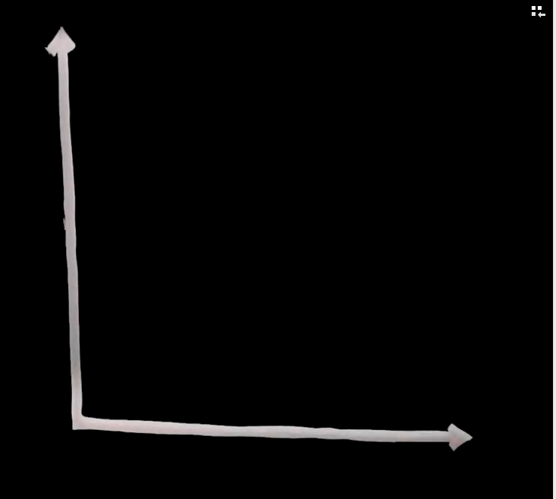





Slide 68
Projects we have
done many times.
in a well know area we have worked before.
We had low technical complexity.
We refer to as : STANDARD PROJECT

Slide 69
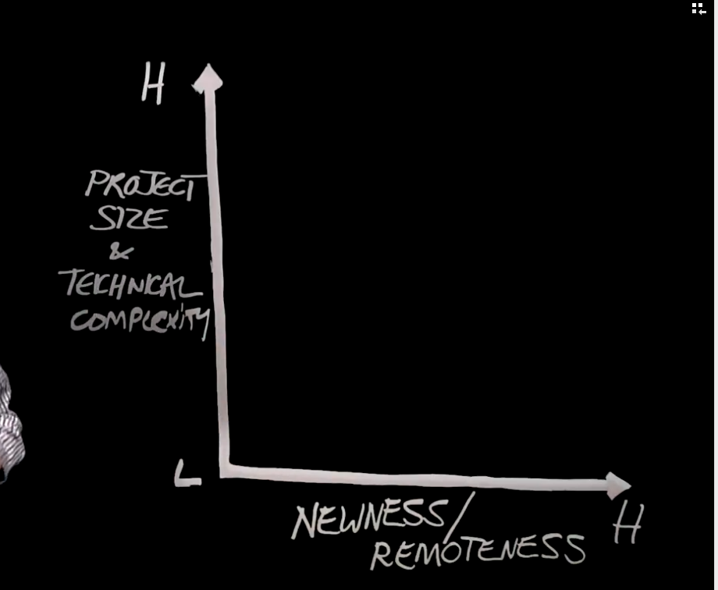

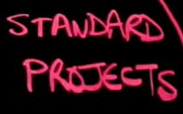
Represent low risk

Slide 70
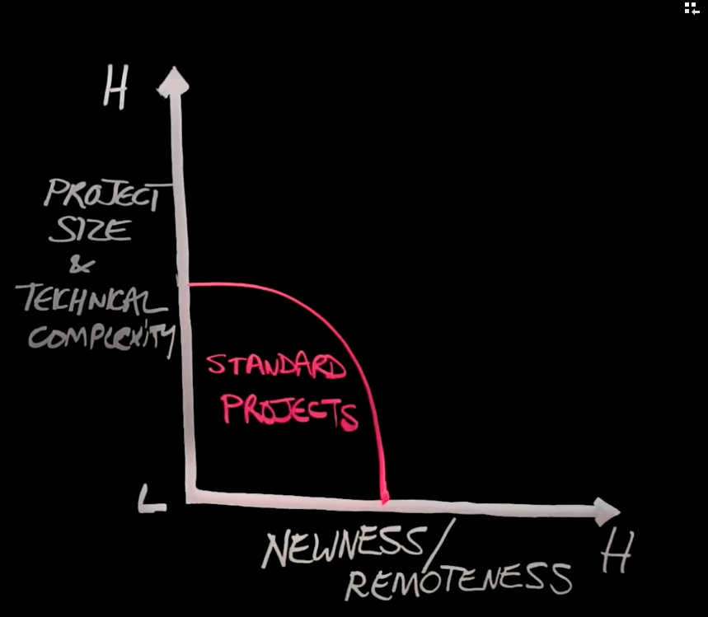
Risks are well known to us
You can consult people worked in previous similar projects

Slide 71
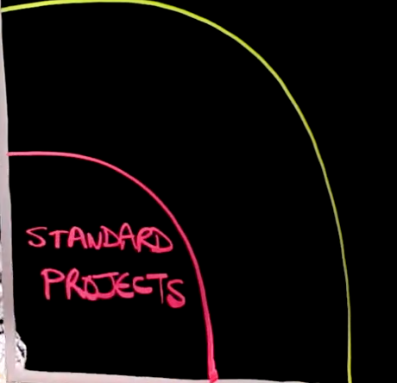

More Technically
complex
but in known area

Slide 72
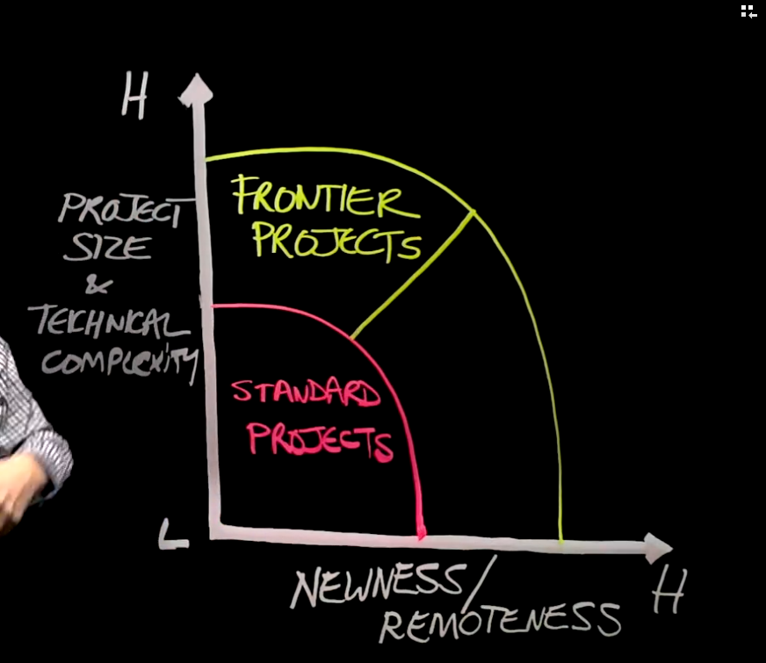
Although in a geographical Area Known to us
They have additional technical risks

Slide 73
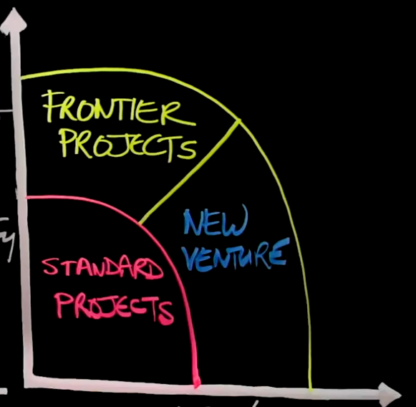
We do project in our technical capabilities
But in different locations
So we must take consideration about new variables
In the unknown environment
Technical Complexity
Still Low
Move into
New Geographical location

Slide 74
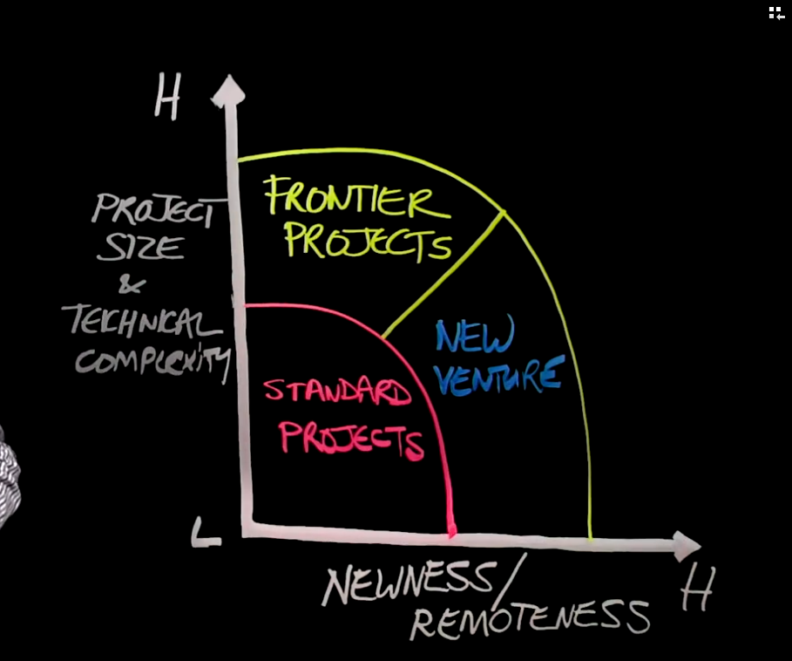


Highest possible risk to us
High complexity
And
Large project
Delivered
Remotely

Slide 75
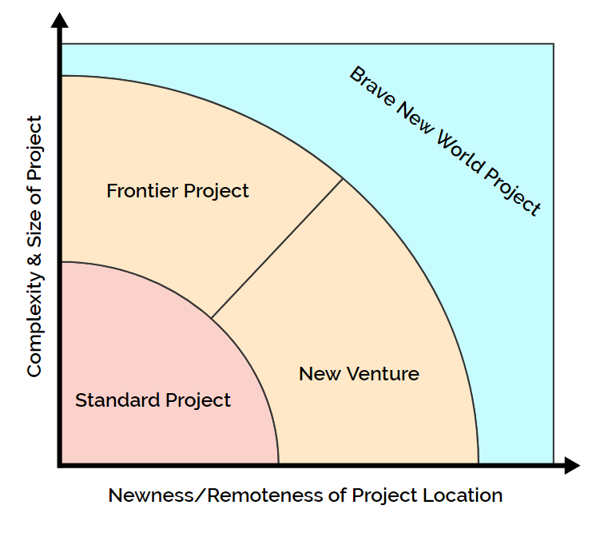
Summary of different project types

Slide 76
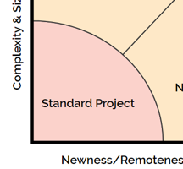
Standard Projects:
Have managed before
you have seen it many times.
It is within your existing capabilities to manage.
Lessons learnt from previous Standard Projects would be very beneficia.
risks would be well-known and sufficiently managed,
Hence Standard Projects are considered to have lower uncertainty.
You may not need to undertake as much risk management work.

Slide 77
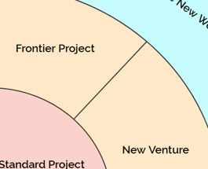
New Frontier or New Venture Project
The project is either one that you have not managed before OR undertaken in a location environment in which you have never been before.
Lessons learnt from Standard Projects may be of some benefit.
The uncertainty profile is higher
You would need to undertake more risk management work
In a Frontier Project, technical risks could be significant.
In a New Venture Project, non-technical risks could be more prominent.

Slide 78
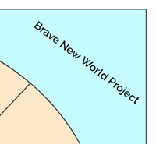
Brave New World Projects
The Western Savannah case is a Brave New World Project.
We take on a project that we have not seen or managed before.
In a location or environment that we are unfamiliar with.
Lessons learnt from Standard Projects may not provide much benefit.
We would recommend a robust application of the risk management process.
Deemed to have the highest level of uncertainty.
Sufficient time and effort needs to be given to managing this uncertainty.

Slide 79
4 Where to now?

Slide 80
Bringing the risk register together
The risk register provides us with a list of risks identified, stated clearly and assessed relative to their importance of meeting projects' objectives.
The risk register further records a risk response and the details of the risk owner

Slide 81
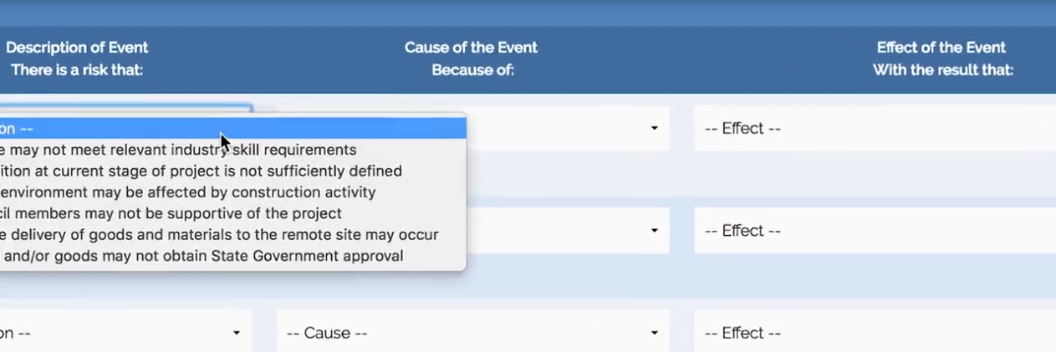

Slide 82
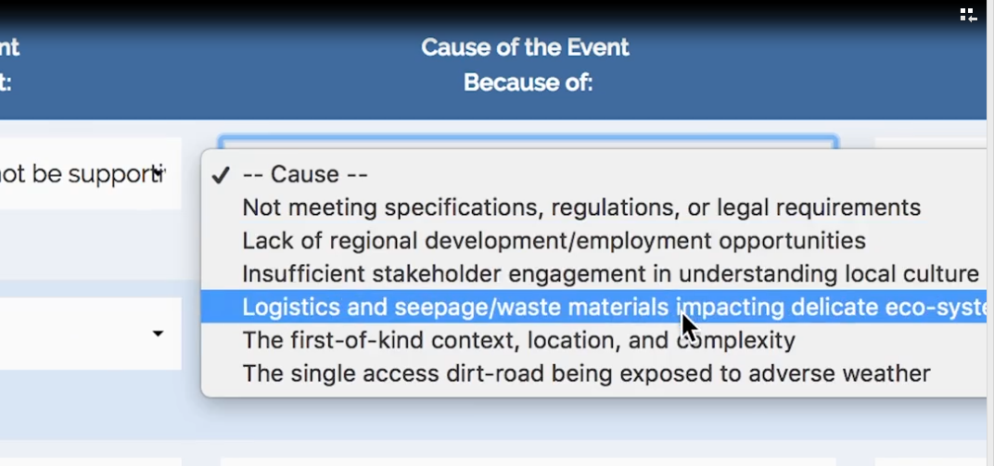

Slide 83
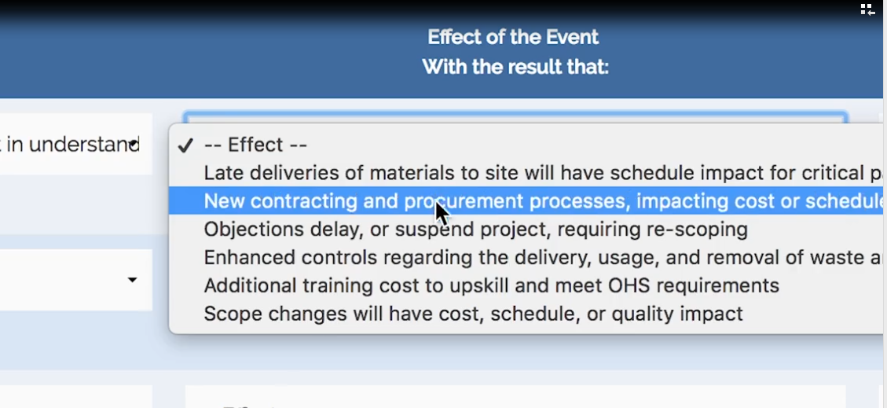

Slide 84
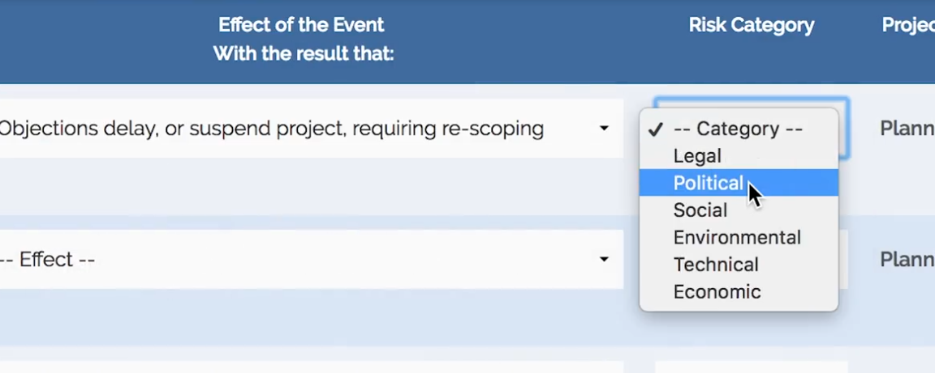

Slide 85

Risk Response
Risk Owner

Slide 86

we needed to clarify our project objectives.
we then identified and categorized our risks
risks were discussed and described using
a cause and effect statement structure

Slide 87
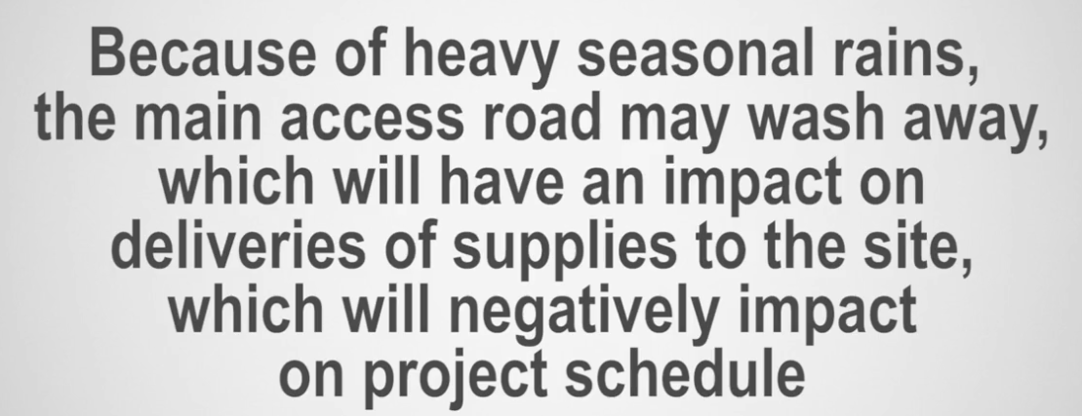
Example :

Slide 88
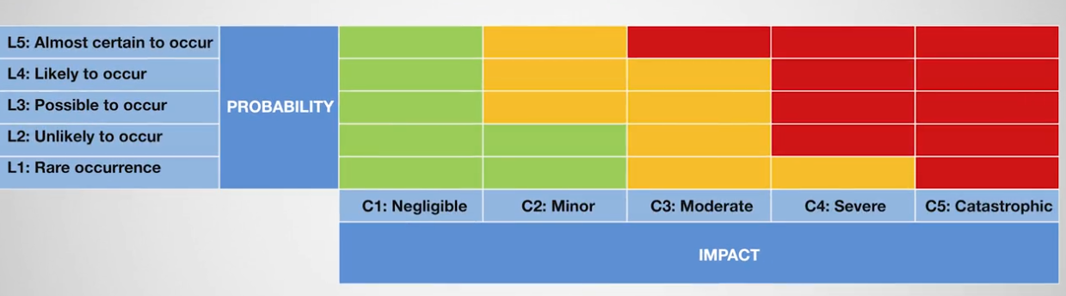
Risk Assessment
Medium
High
Low

Slide 89

Risk Owner:
Every risk is assigned to a person who is given ownership of an identified risk or risks.

Slide 90

Risk owner responsibilities:
Responsible for planning a response using available resources or acquiring additional resources.
Ensure that the action is identified, planned, implemented, and monitored.

Slide 91

Risk Response :
Risk responses should be :
planned,
budgeted,
staffed,
scheduled, and
managed
like any other important project activity.

Slide 92

Risk Response :
Risk responses need to be :
specific
actionable,
appropriate to the risk and
likely to be effective.

Slide 93
What other benefits can you think of that the creation and maintenance of a risk register provide to you and your projects?

Slide 94
Risk register benefits:
A central repository for the risk information.
Gives stakeholders a clear view of the status of each risk at any point in time.
Help you and your stakeholders to understand the nature of the risks faced within your project.
Record the type of risk and how it could likely affect the project

Slide 95
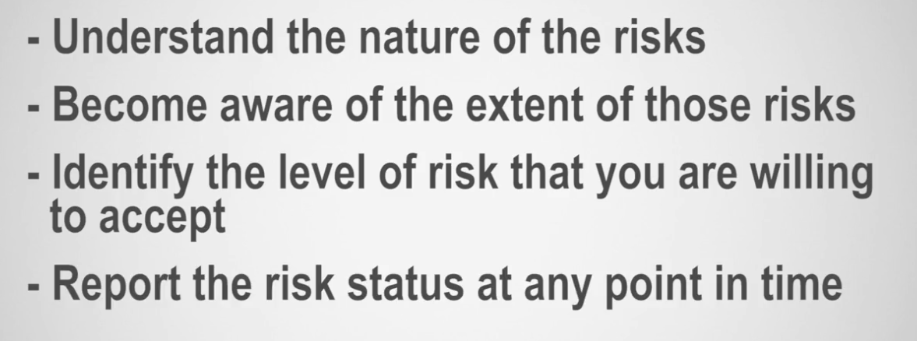
Risk register will help you :

Slide 96
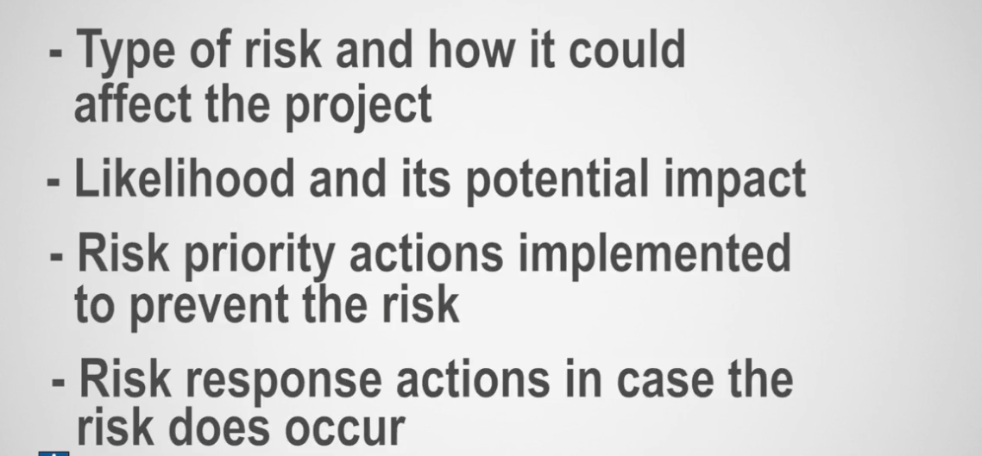
Risk register will help you understand :

Slide 97
5 Discussion:
Risk response

Slide 98
6 FAQ

Slide 99
Feed back

